Slide 1

Overview OF Poverty, education, and employment in the world
Data visualization and exploration
Rachel Fanti Coelho Lima

Slide 2
Goal and motivation
Analyse indicators related to poverty, education and employment in the world, trying to find interesting conclusions.
Where do the world’s poorest people live today?
Which countries have the most problems related to education?
Which countries have evolved the most in the last years?
The higher the unemployment the higher the poverty?
How much difference in income has the richest 10% of the population compared to the poorest? Where are these differences most discrepant?
Is a more educated society more or less equal?

Slide 3

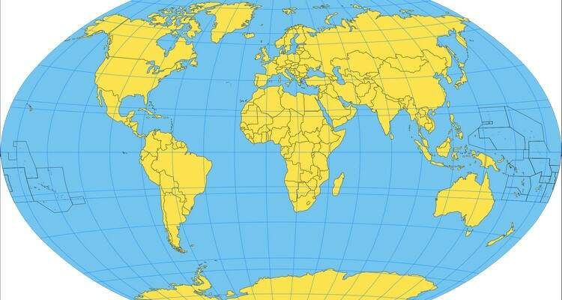
Dataset
World Development Indicators (https://databank.worldbank.org)
Indicators
Economy
Education and Environment
Health and Poverty
PublicSector_Indicators
Energy

Slide 4
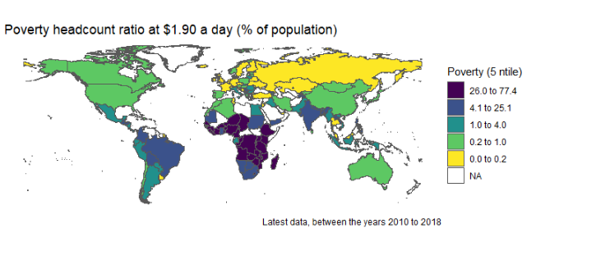
Where do the world’s poorest people live today?

Slide 5
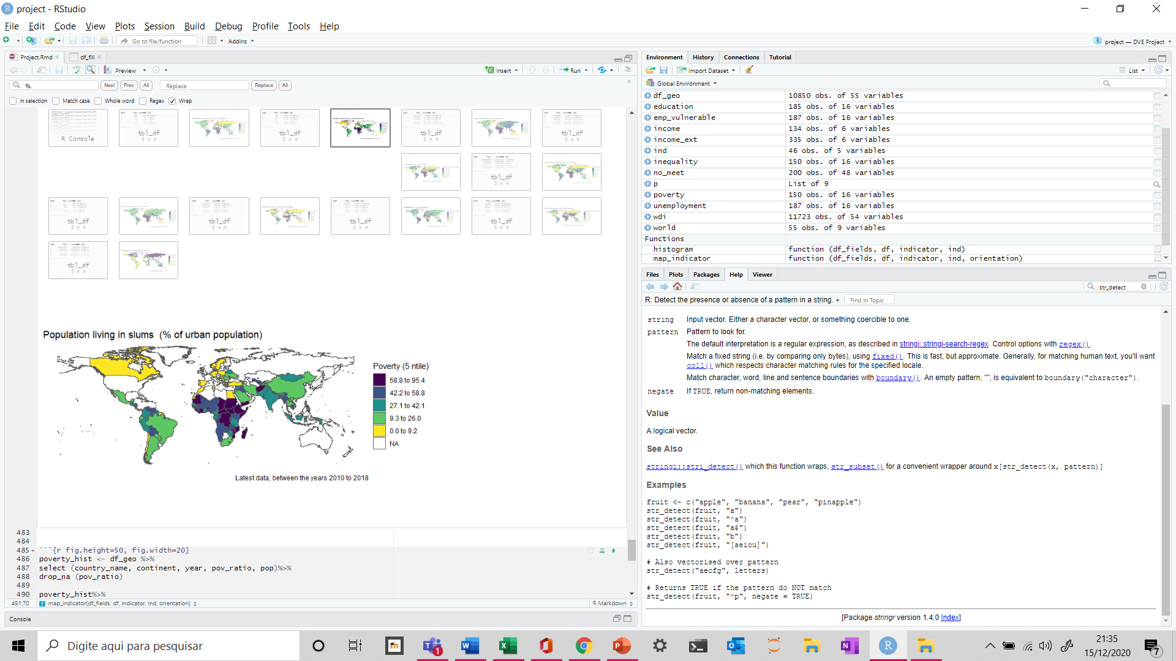
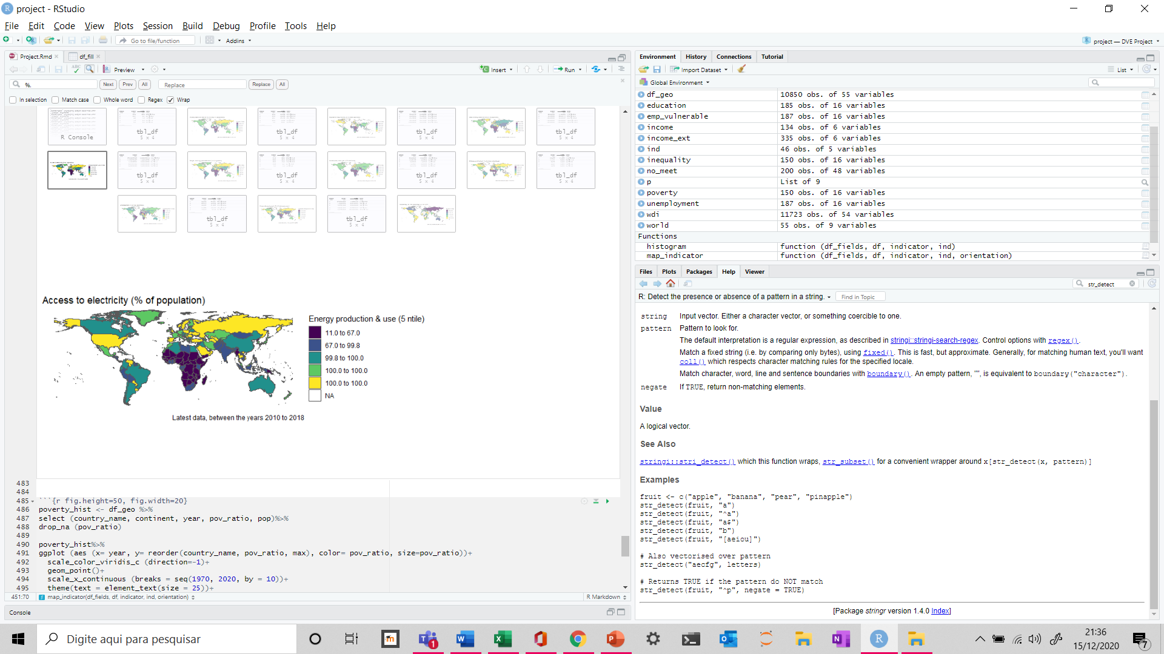
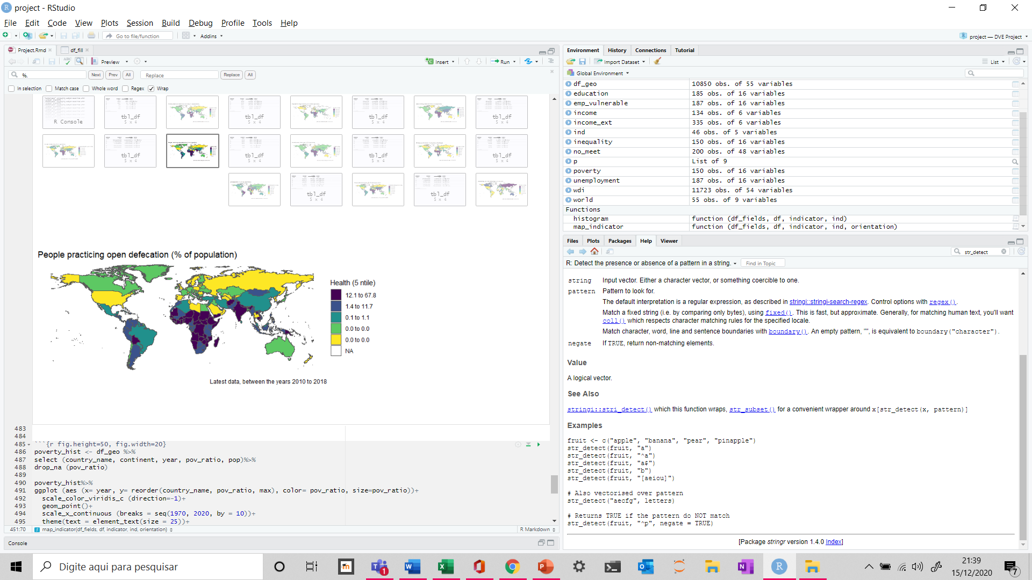
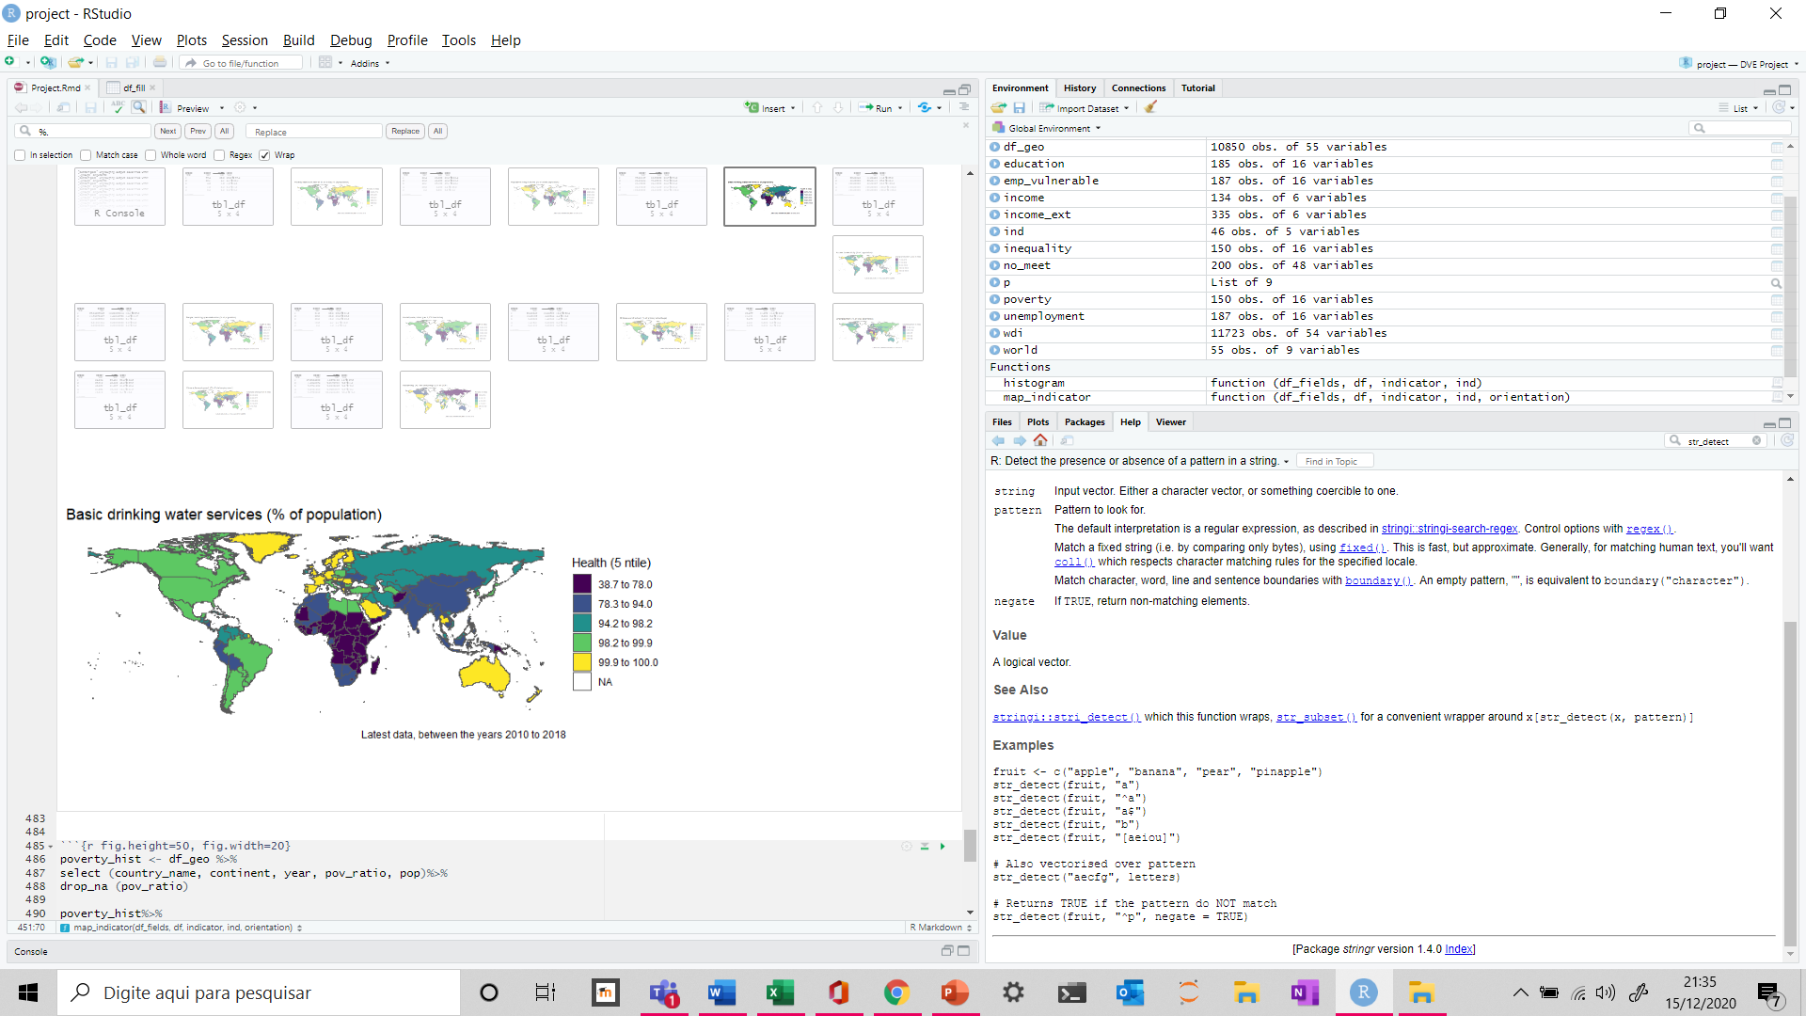
Under what conditions people live today?

Slide 6
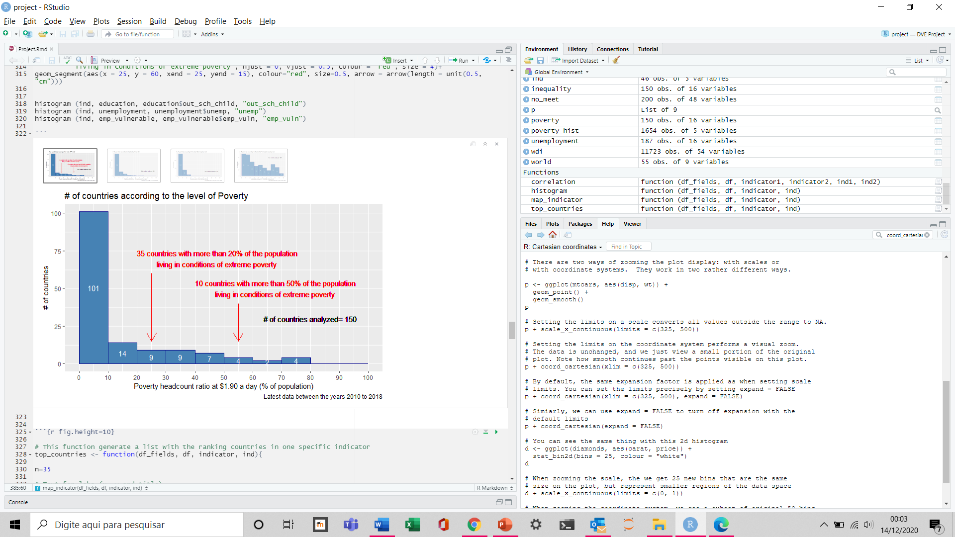
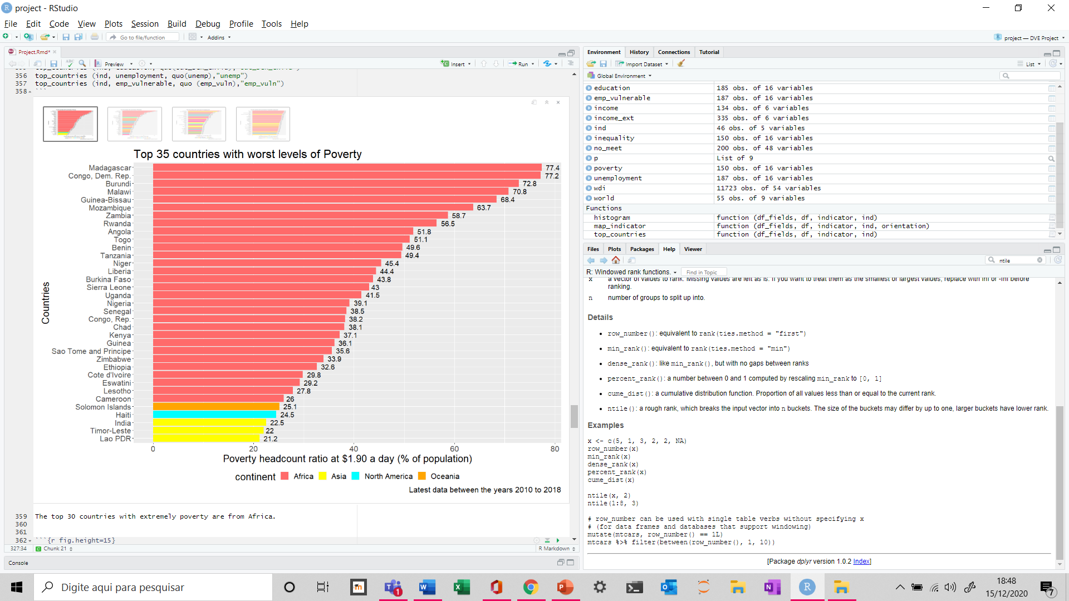
Where do the world’s poorest people live today?
The top 30 countries with extremely poverty are from Africa.

Slide 7
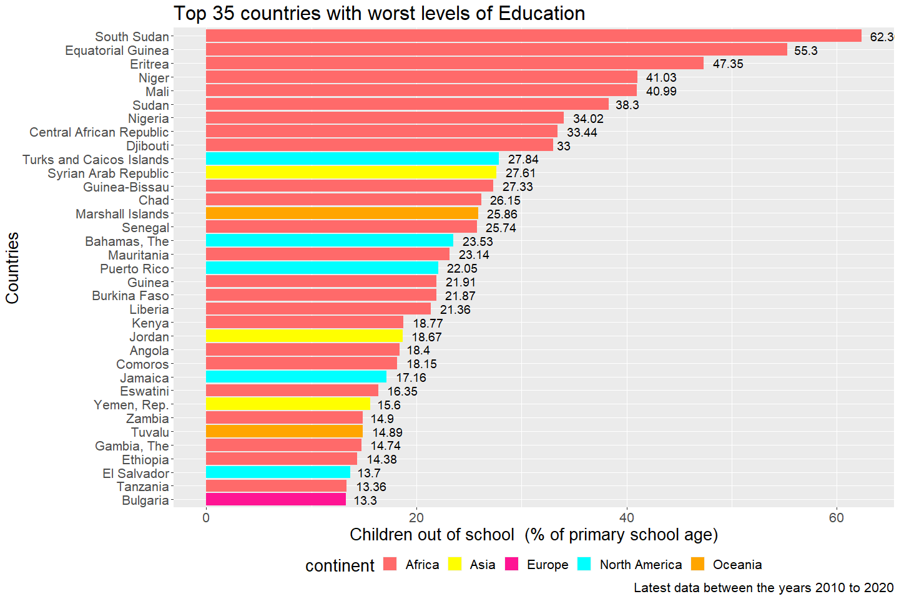
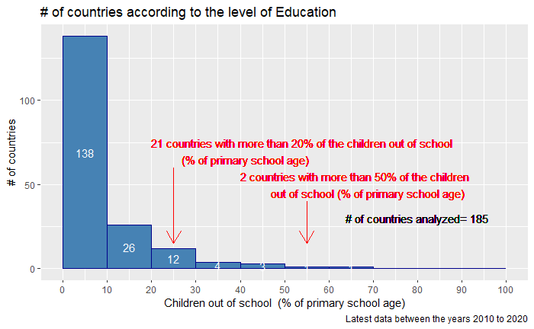
Which countries have the most problems related to education?

Slide 8
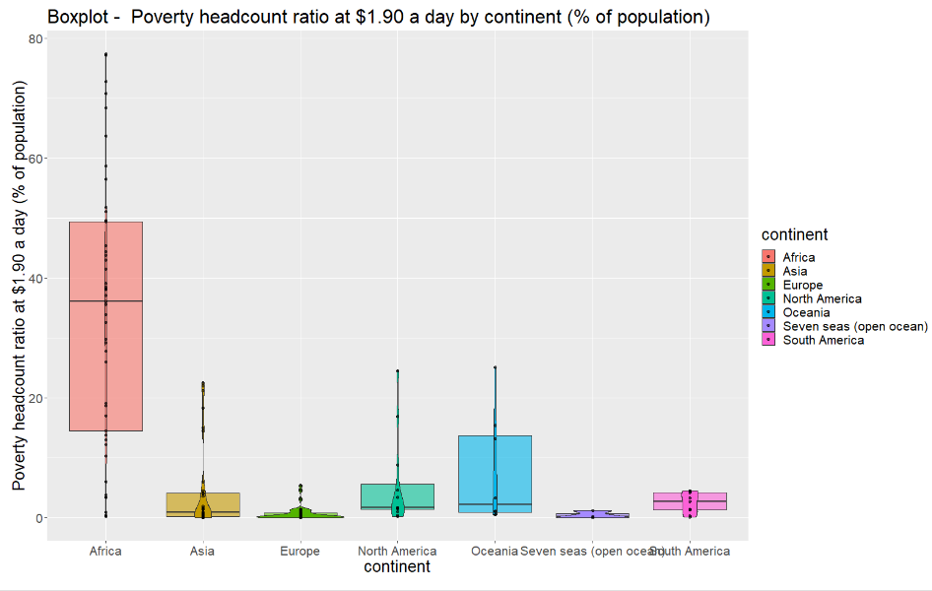
How is the behaviour of extreme poverty by continent?

Slide 9
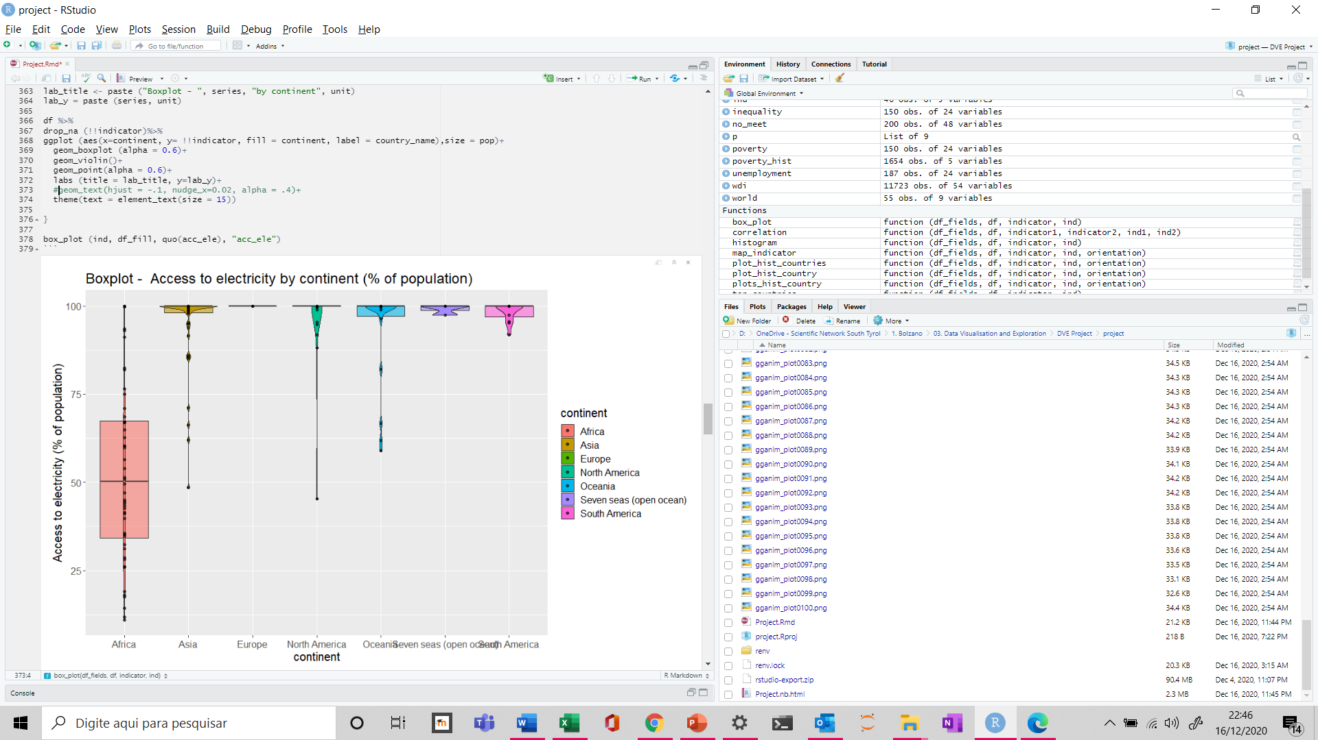
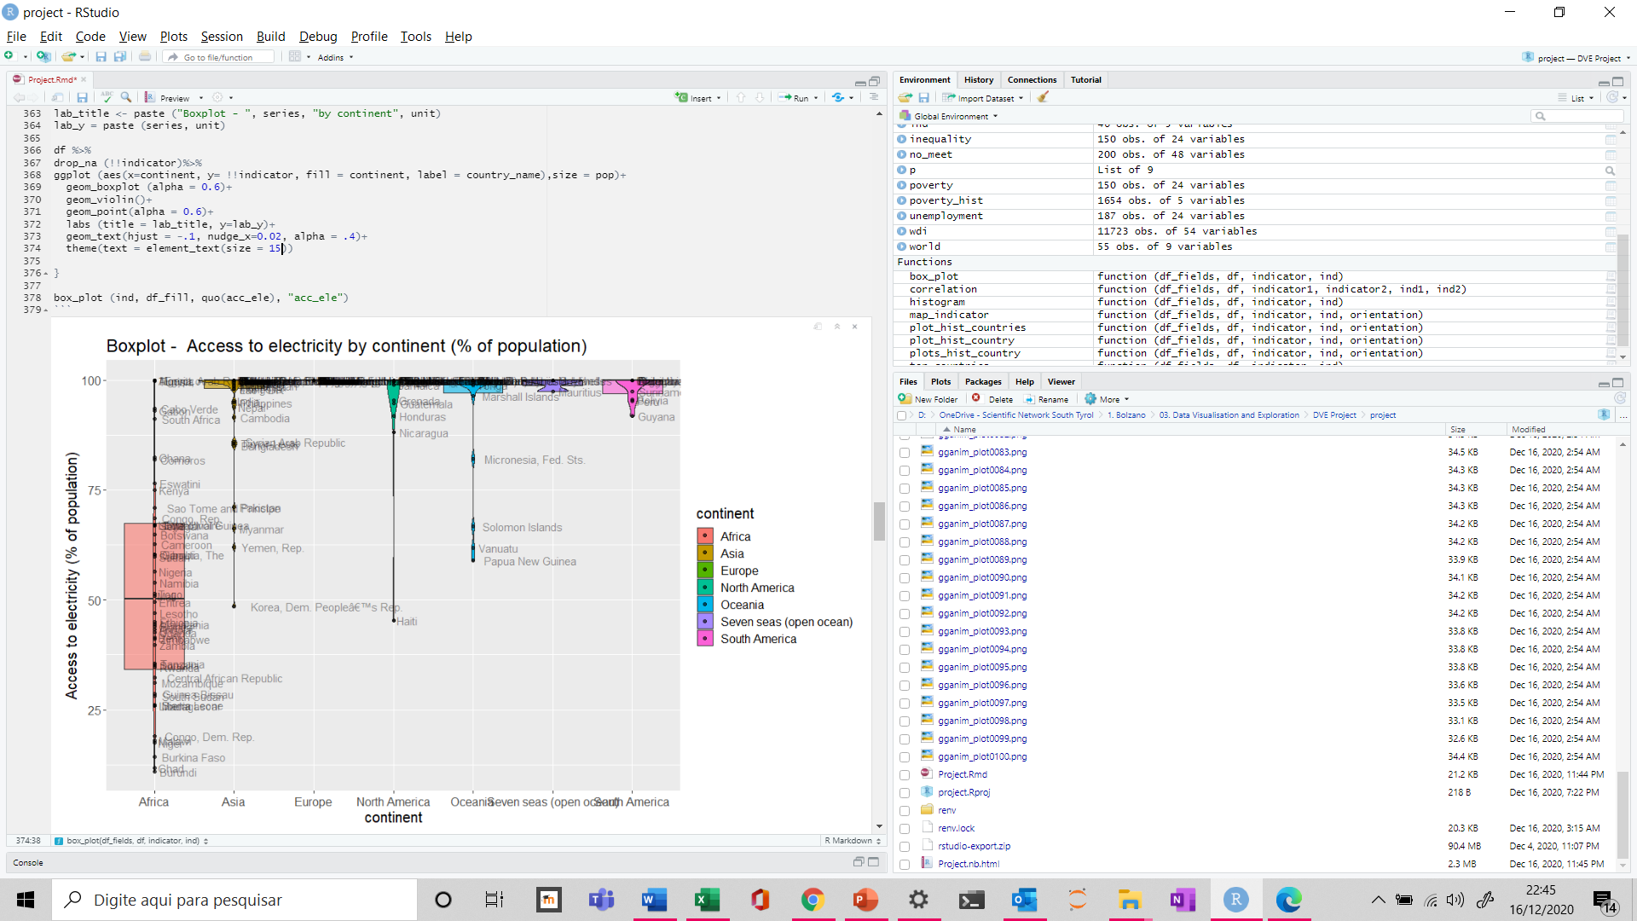
What percentage of the population has access to electricity by continent?

Slide 10
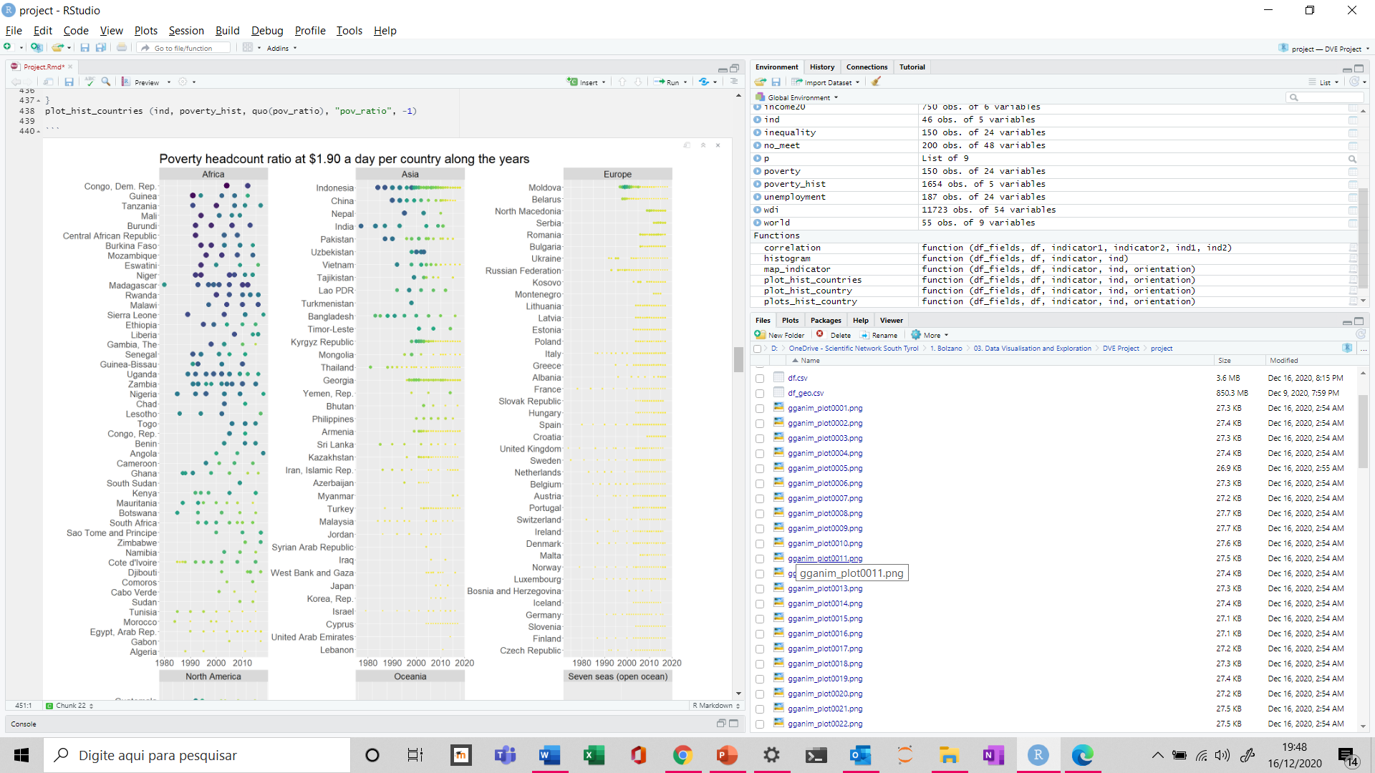
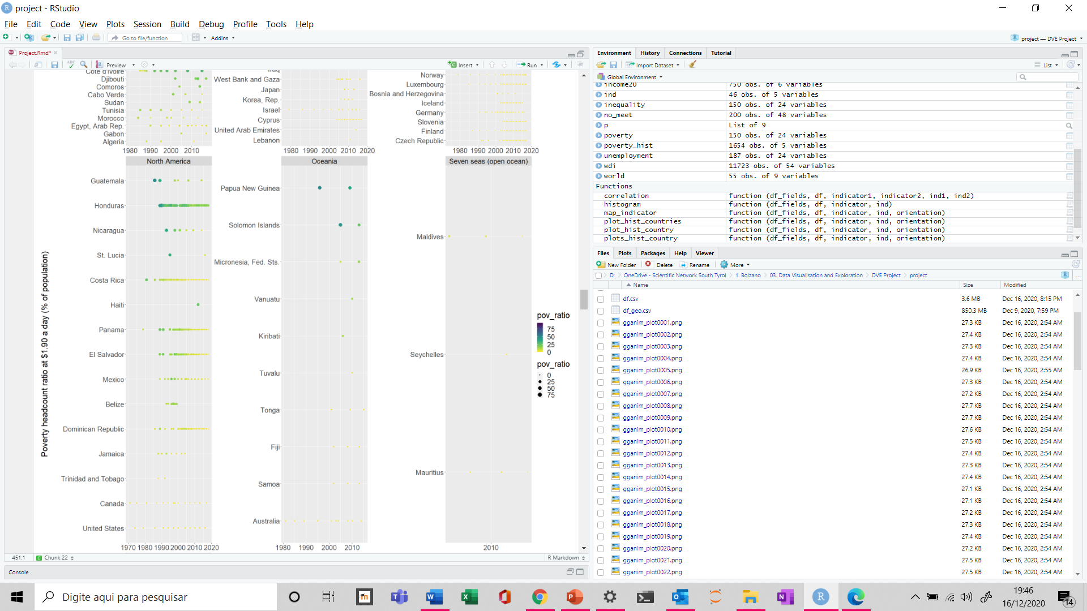
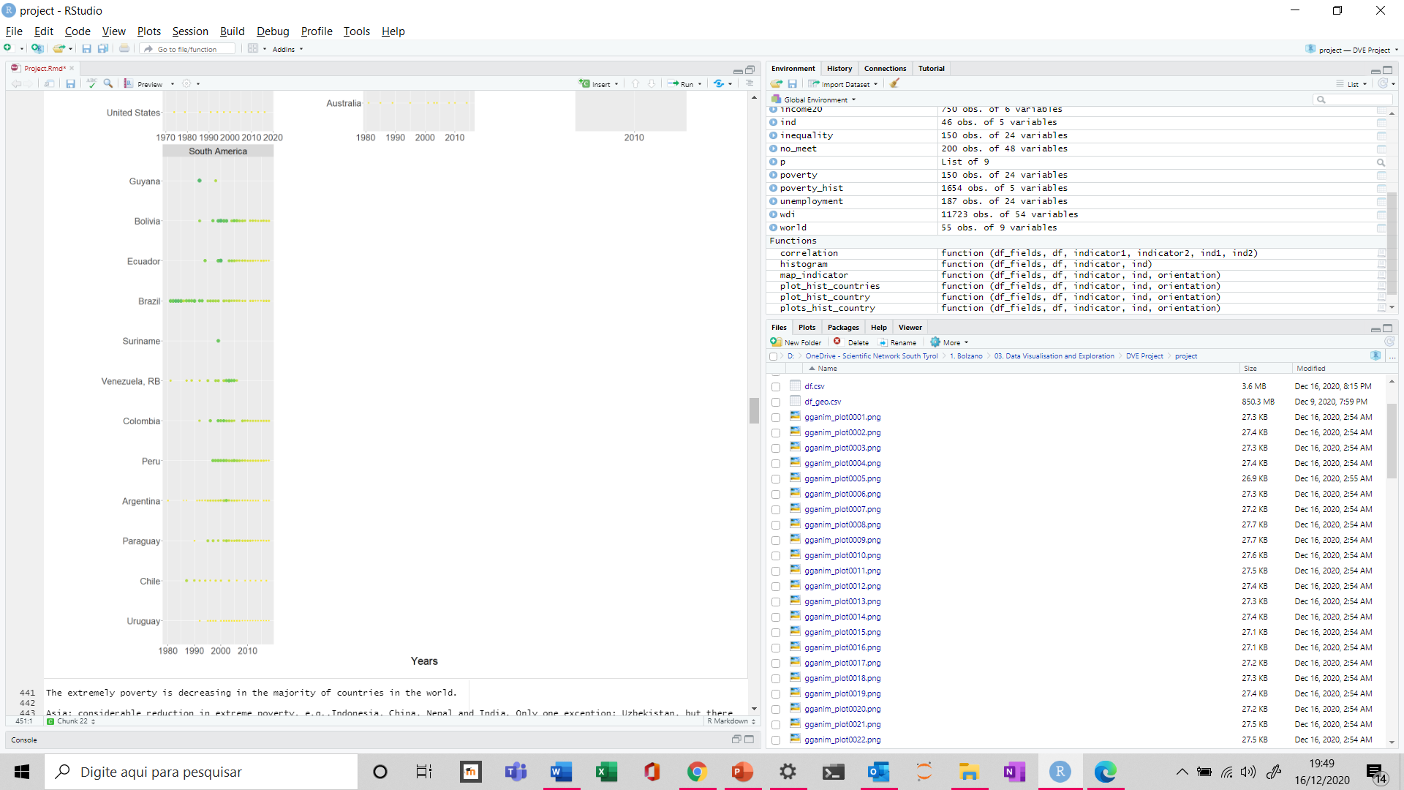
How has evolved poverty per country along the years?

Slide 11
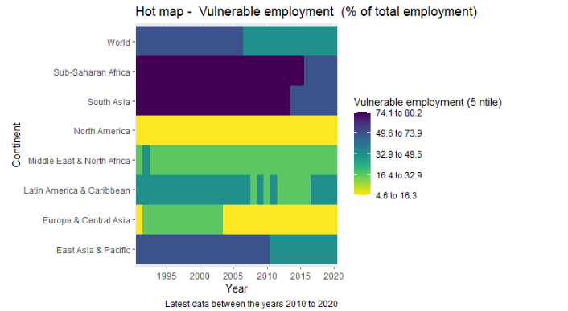
How has evolved the vulnerable employment by continent along the years ?

Slide 12
How has evolved the unemployment by continent along the years ?

Slide 13
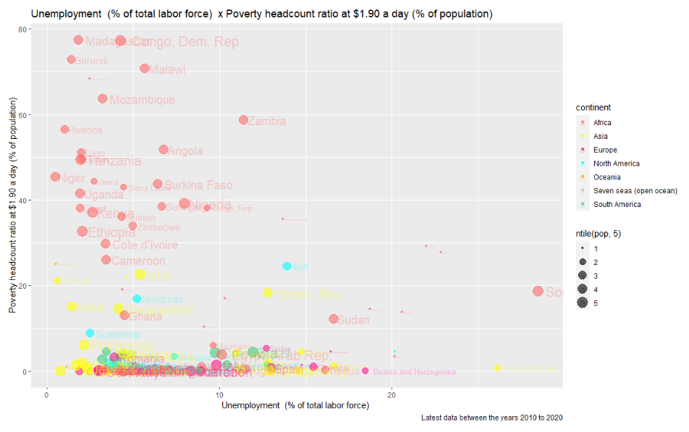
The higher the unemployment the higher the poverty?

Slide 14
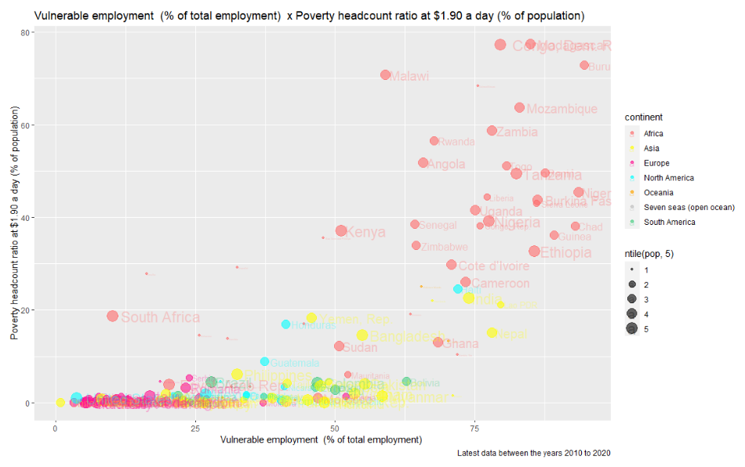
The higher the vulnerable employment the higher the poverty?

Slide 15
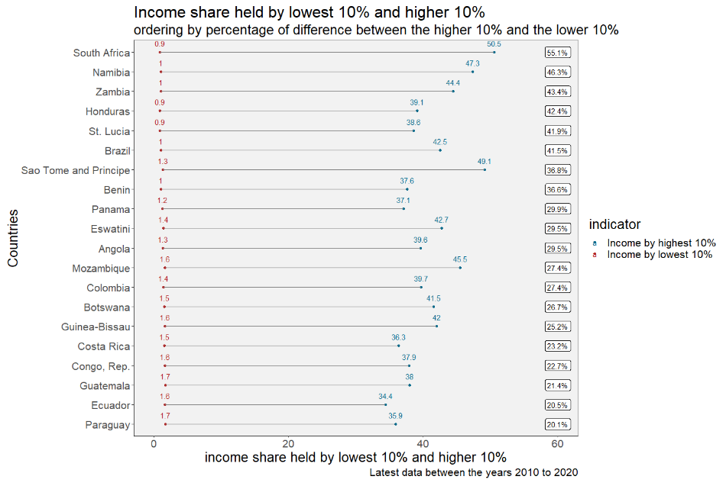
How much difference in income has the richest 10% of the population compared to the poorest? Where are these differences most discrepant?
South Africa is the country with the greatest percentage difference between the income share held by higher 10% and lowest 10%, followed by Namibia and Zambia.
The 10% of the population with the highest disposable income in South Africa received 55 times as much income as the 10% with the lowest disposable income.

Slide 16
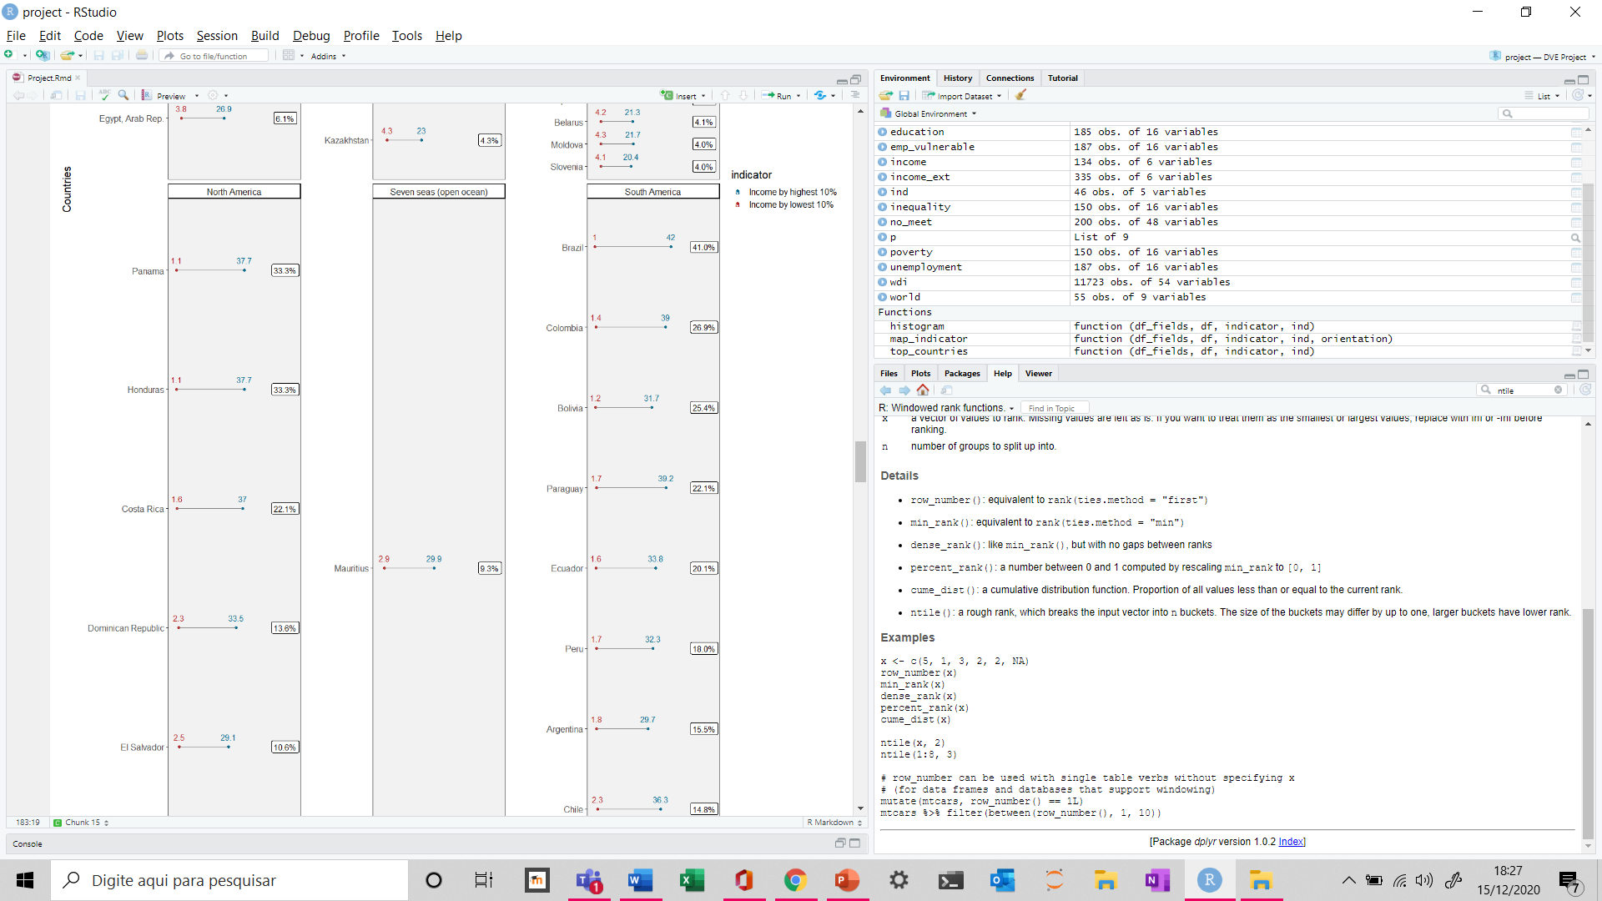
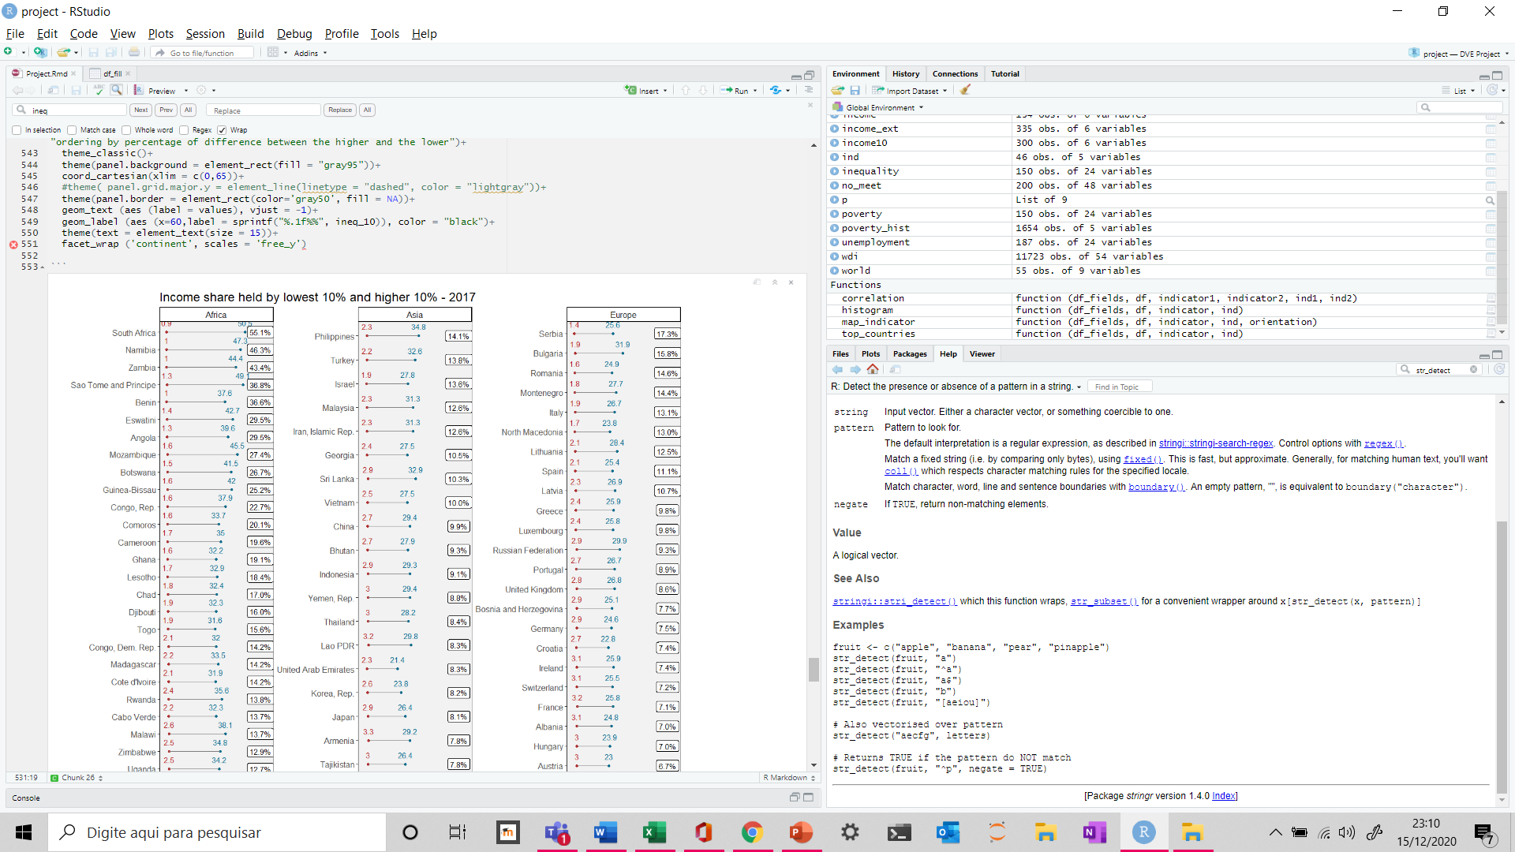
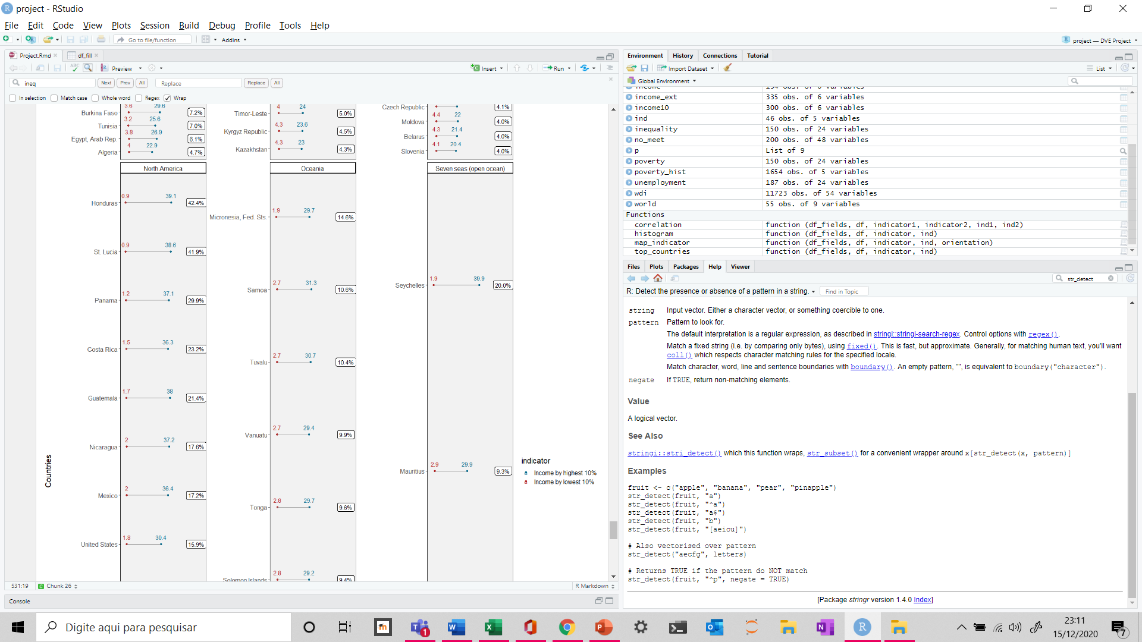
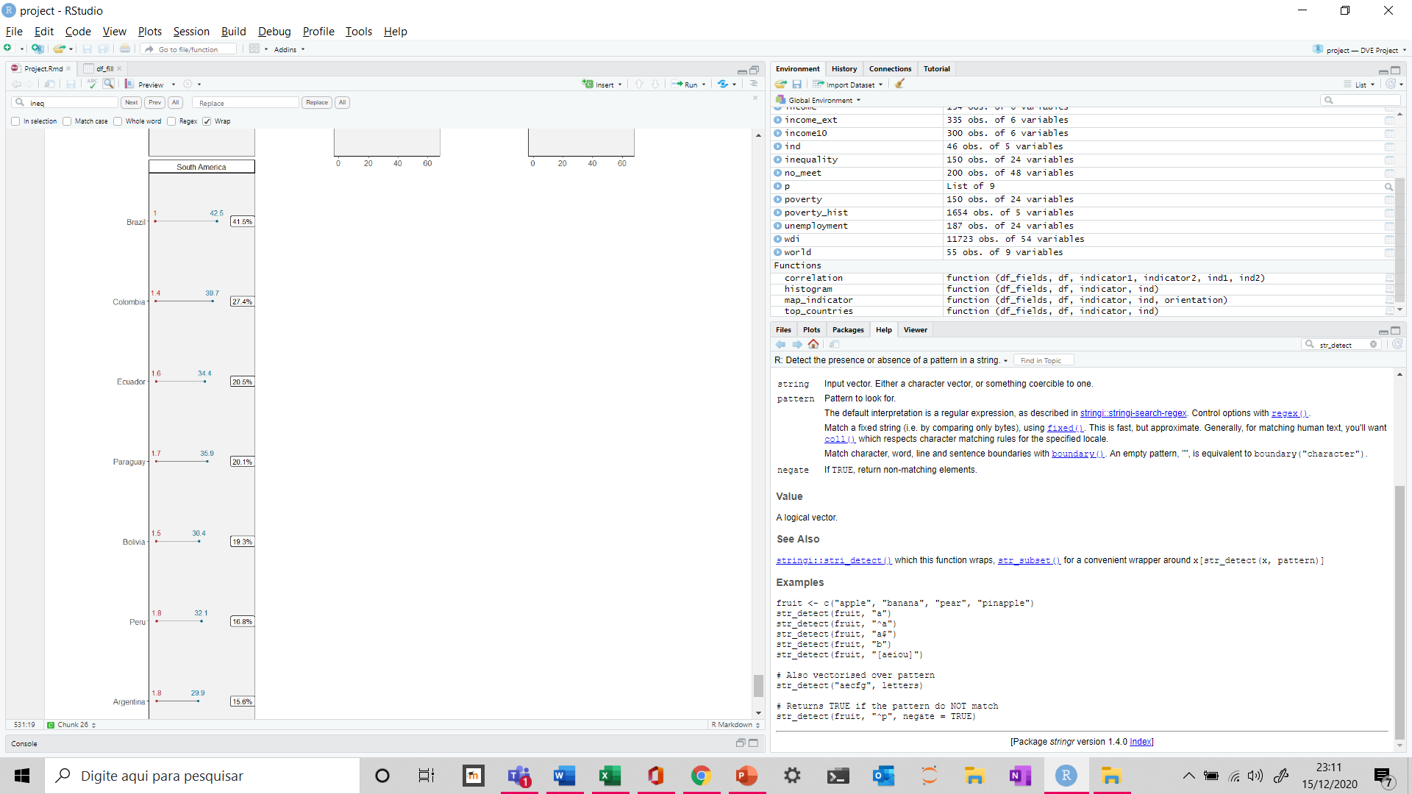
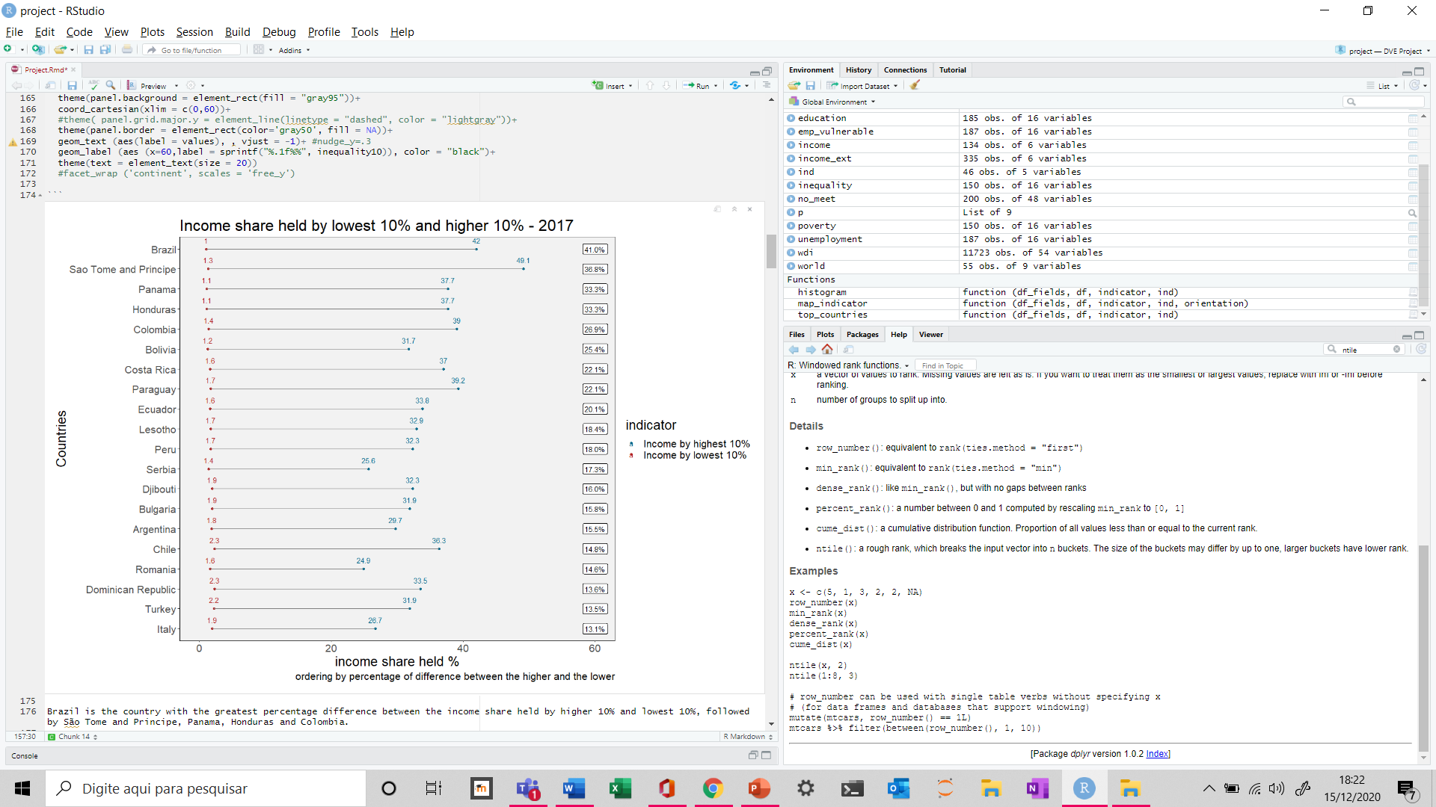
How much difference in income has the richest 10% of the population compared to the poorest? Where are these differences most discrepant?
By continent

Slide 17
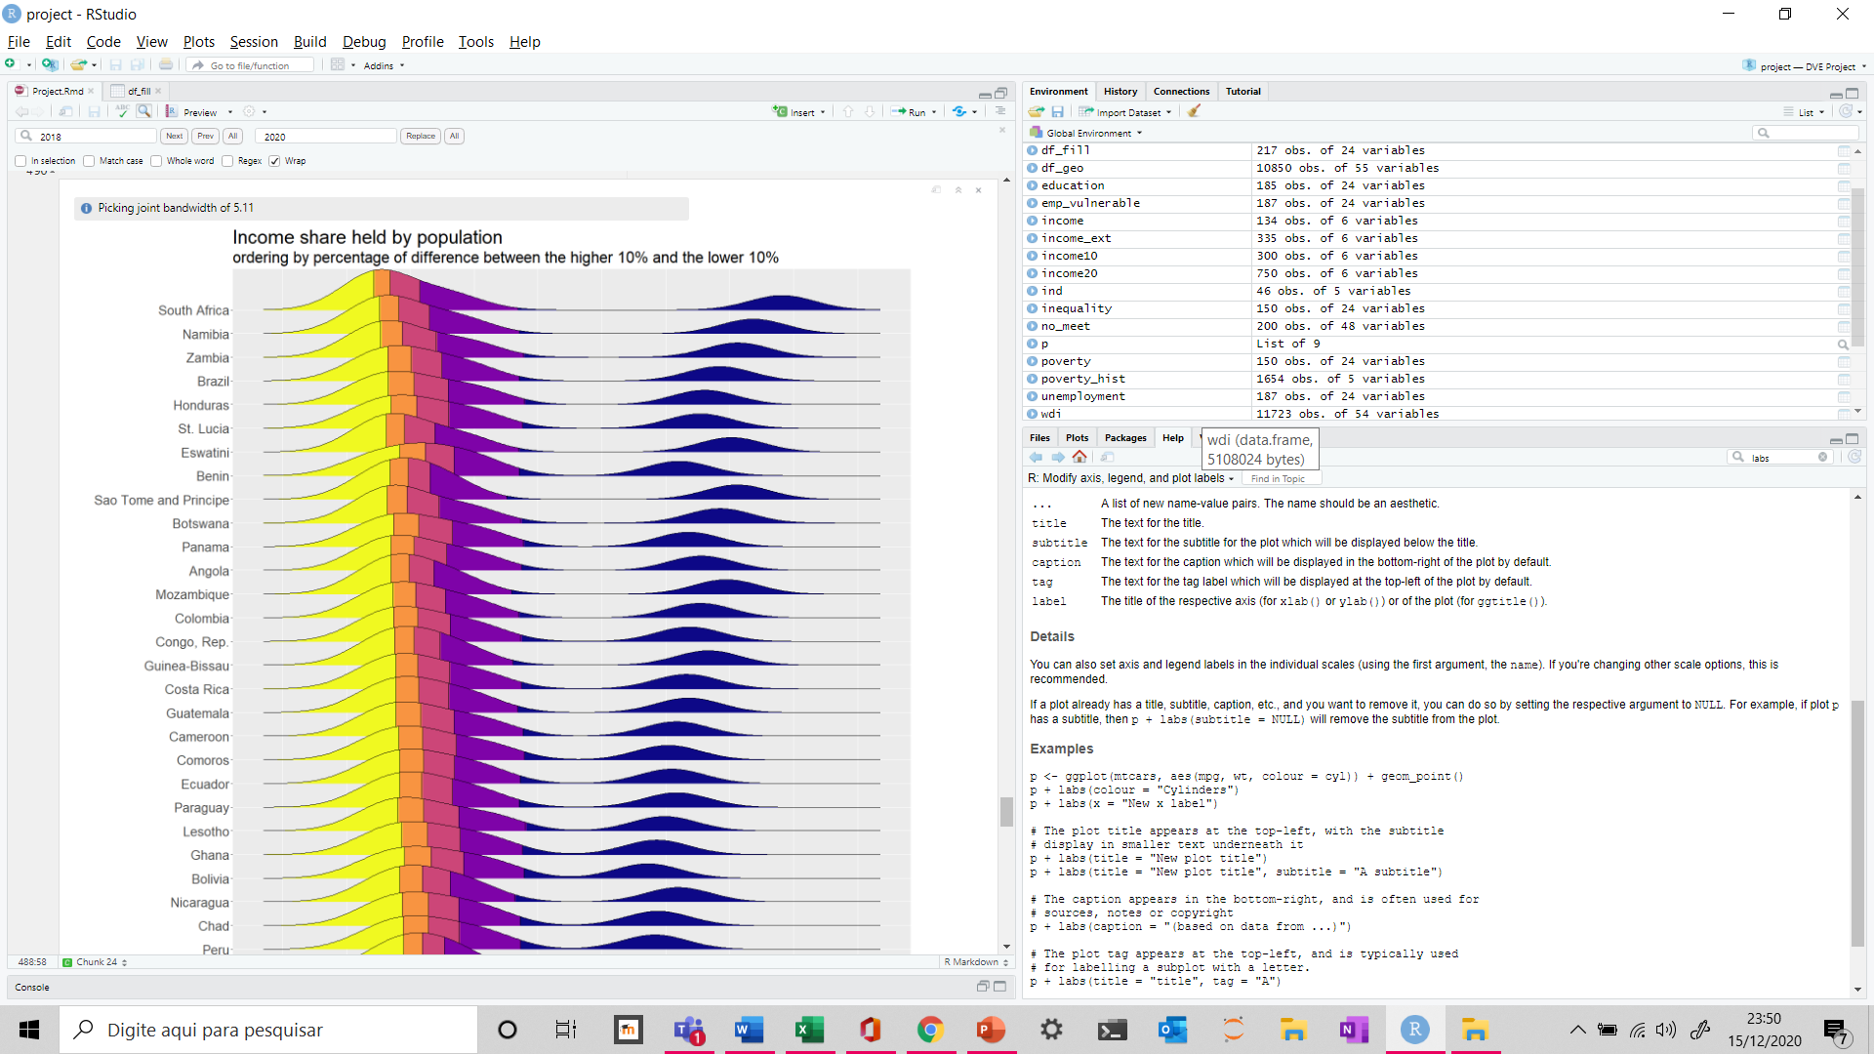
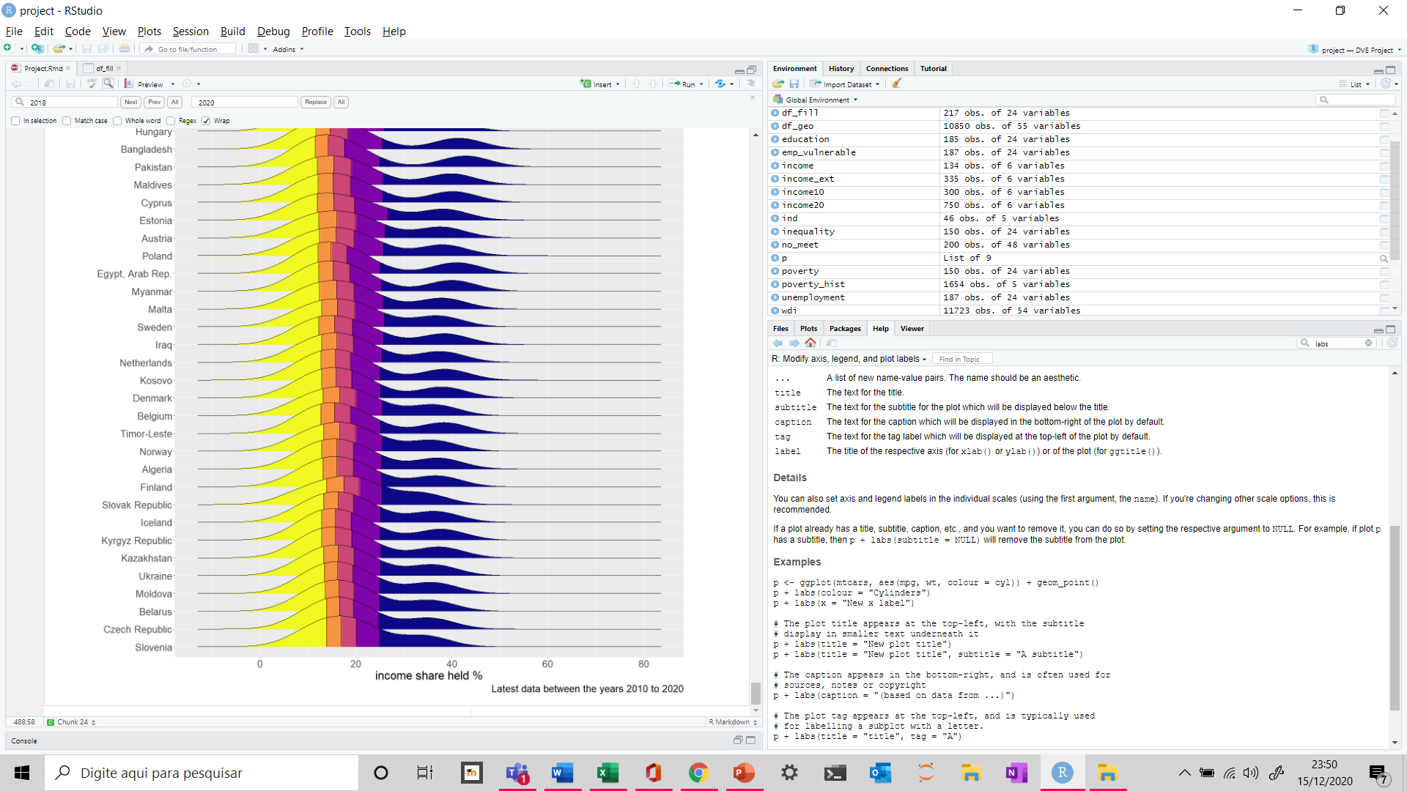
How much difference in income has the richest 20% of the population compared to the poorest 20% and to the other quintiles?
…
…
Notes:
Income share held by lowest 20%
Income share held by 2nd quintile 20% - 40%
Income share held by 3rd quintile 40% - 60%
Income share held by 4th quintile 60% - 80%
Income share held by 5th quintile 80% - 100% (are the richest 20%)

Slide 18
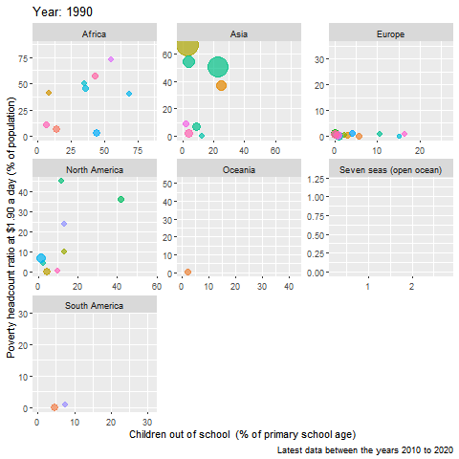
Animated graphic – Poverty x Children out of school
From 1990 to 2020

Slide 19
Programming and Visualisation for Data Analytics
E-mail: rachel.fanticoelholima@stud-inf.unibz.it

Slide 20
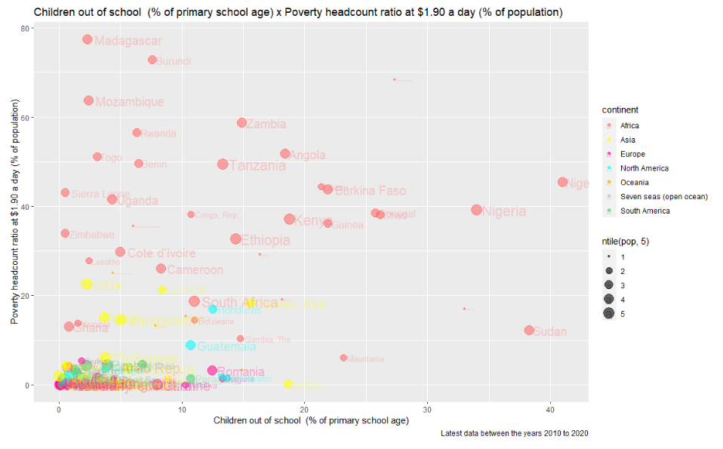
The lower the education the higher the poverty?

Slide 21
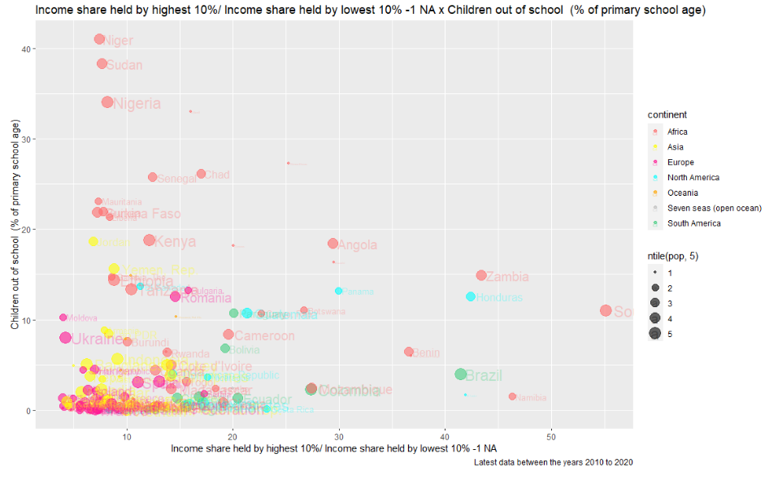
Is a more educated society more or less equal?

Slide 22
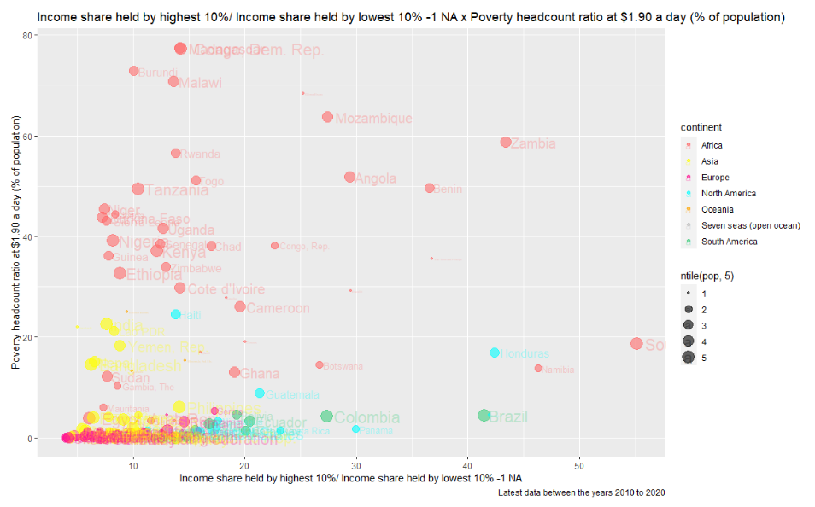
Is a more poverty society more or less equal?

Slide 23
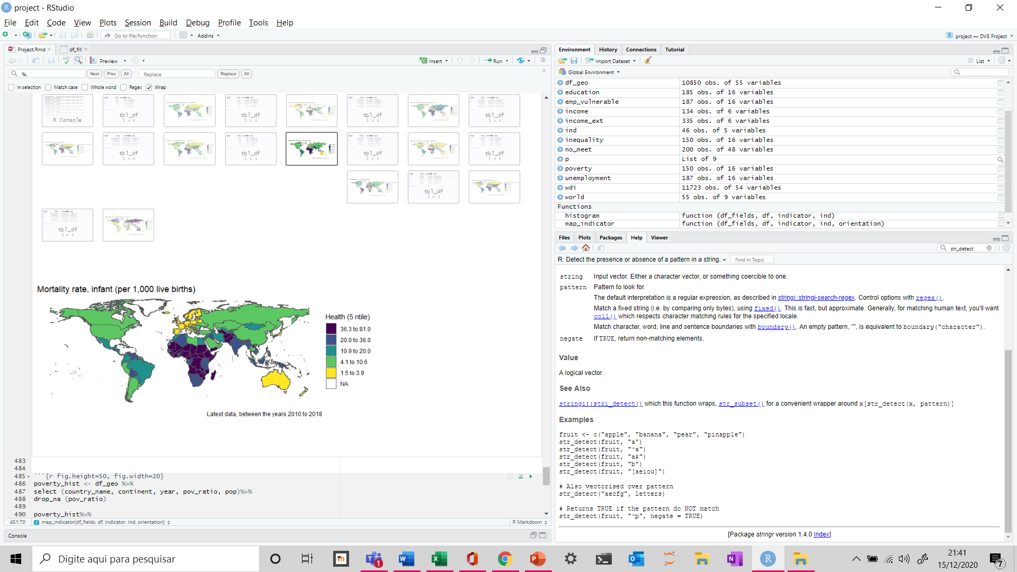
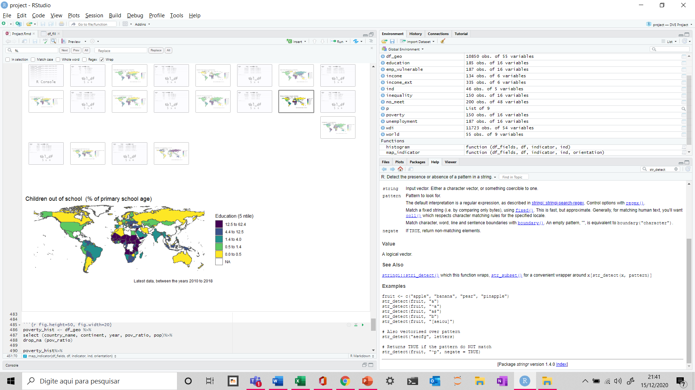
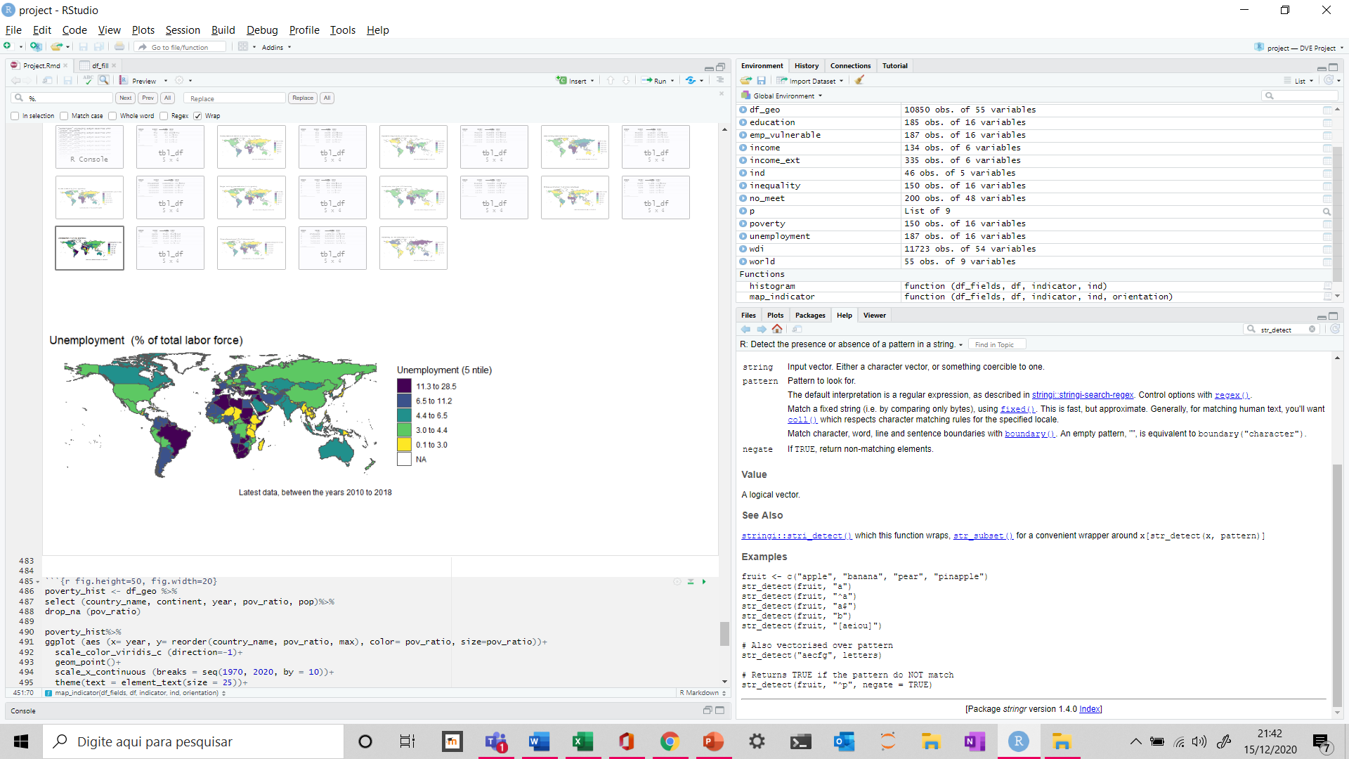
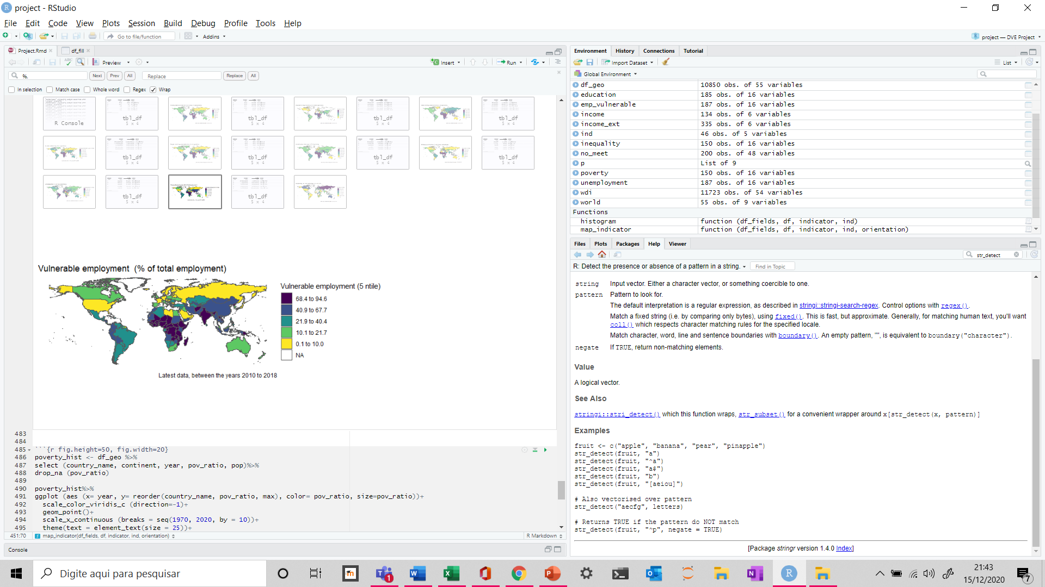
Under what conditions the world’s poorest people live today?

